Slide 1

Supply Chain and Targeted HFA Spot Checks
Country report: ABCD
[period of survey]
Date:
Disclaimer: “The opinions expressed in this presentation and on the following slides are solely those of the presenter and not necessarily those of IQVIA. IQVIA does not guarantee the accuracy or reliability of the information provided herein.”

Slide 2
Introduction
Objectives of Spot-checks & tHFA
Process - Steps involved & where we are now…
Technical details – We went to Sampled facilities, (# of HFs) with select, tracers list (# of tracers), & also at central level and following 5 indicators assessed for performance
Why – Shift in TGF strategy to focus on IPCQS, community health. Collecting performance framework metrics to monitor progress

Slide 3
Key tHFA sections with KPI and Non-KPI with broader message
Sections level details (take from previous slides
KPI and Non KPI linked to each section
Subcomponents of each indicator

Slide 4



Table of Contents
1. Executive Summary
2. Methodology
3. Key Findings
and Insights
Provides a description of the sampling, data quality assurance and the analysis approach, as well as challenges encountered in methodology, if any.
Summarizes the scope, key findings and highlights for the country.
Reflects the key findings and highlights.

Slide 5


1. Executive Summary
2. Methodology
3. Key Findings
and Insights
Provides a description of the sampling, data quality assurance and the analysis approach, as well as challenges encountered in methodology, if any.
Summarizes the scope, key findings and highlights for the country.
Reflects the key findings and highlights.

Slide 6
Executive Summary
Service delivery numbers
# of places visited (primary, sec, ter) & urban rual etc
Areas avoided because of insecurity in any
Indicators at country level

Slide 7

1. Executive Summary
3. Key Findings
and Insights
2. Methodology
Provides a description of the sampling, data quality assurance and the analysis approach, as well as challenges encountered in methodology, if any.
Summarizes the scope, key findings and highlights for the quarter.
Reflects the key findings and highlights.

Slide 8
Methodology: Sampling
MFL used
Sampling – panel and random; any deviation in sampling based on CT requirements;
HTM availability in MFL compared to sampling chart
Any back-up facilities used etc
Final sample collected
Take from training deck

Slide 9
Methodology: Training and Data collection
Training process; material, pre-post test; enumerator finalization
Team composition and structure
Data collection process
Take from training deck

Slide 10
Methodology: Data quality process
Detailed QC process before data collection, during data collection (field level) and post data collection (at desk-level)
Before data collection: Survey CTO checks inbuilt etc
Field level: spot checks, telephonic confirmations, back-checks; add back check results
Post field/desk-level: detailed data quality checks e.g. duplicates, outliers etc and data cleaning steps
IDQA results where applicable
Take from training deck

Slide 11
Methodology: Data Analysis approach
Adapt using annex 1 shared

Slide 12
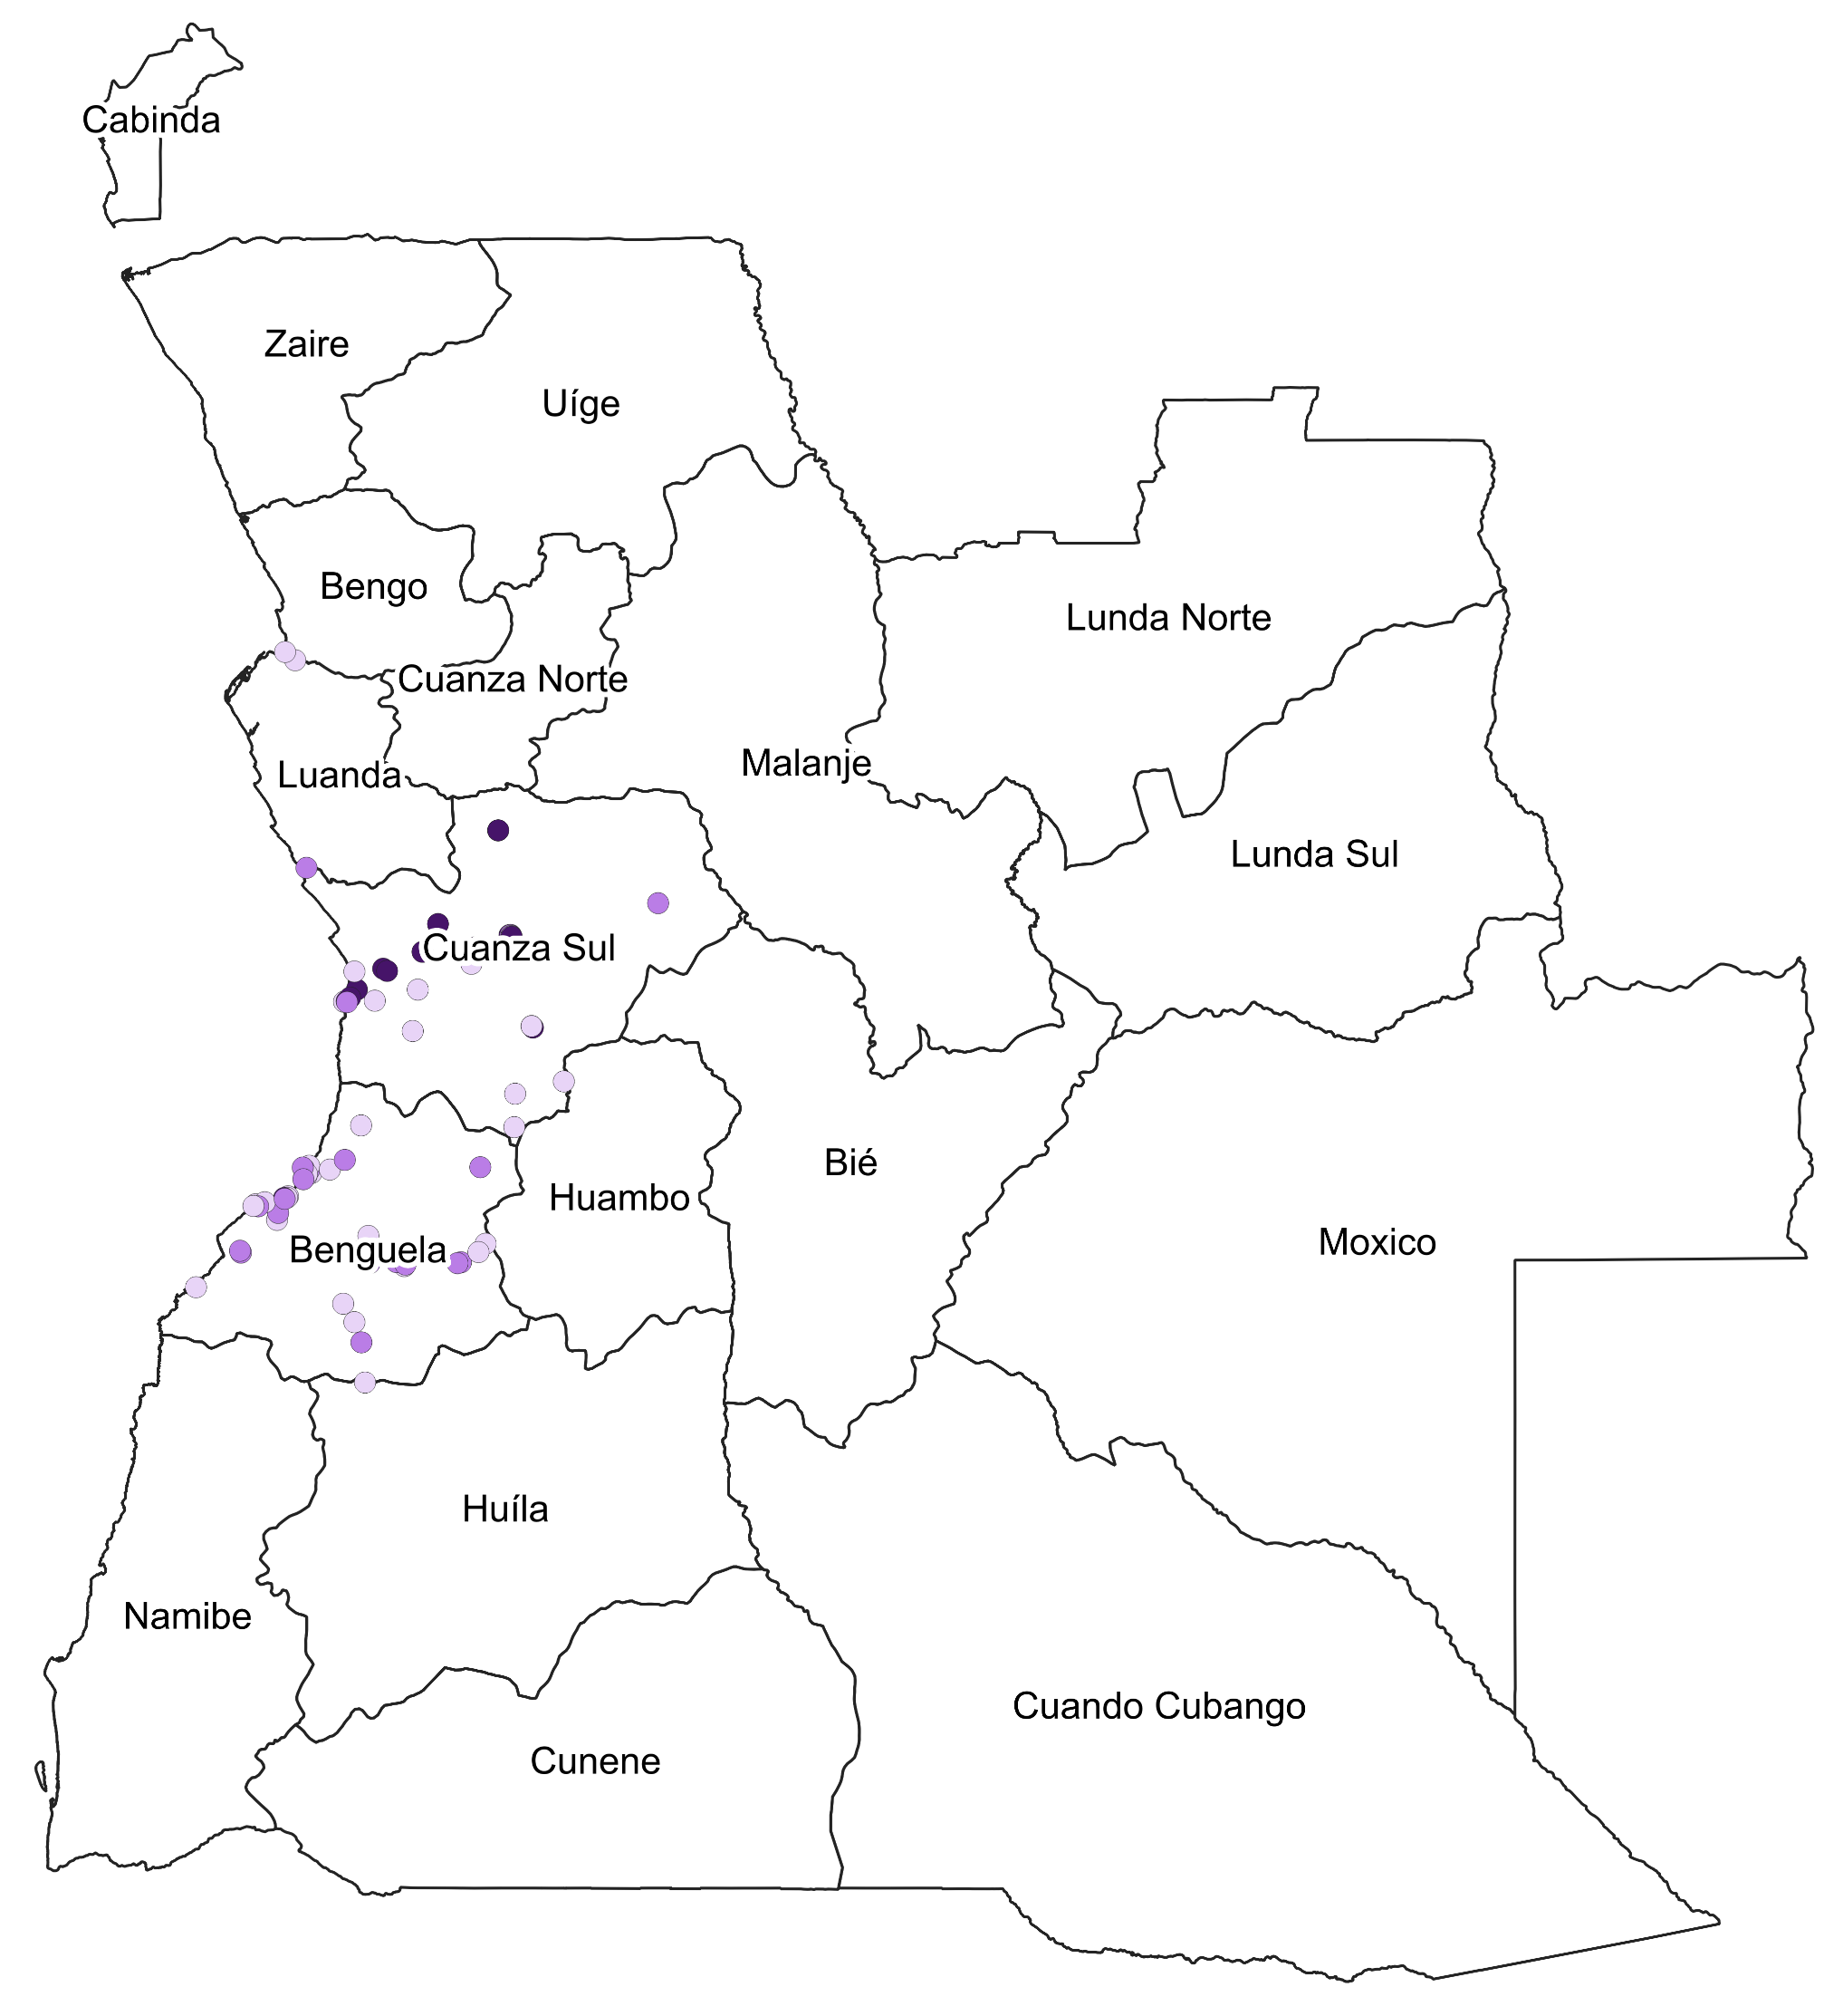



Facility demographics and service availability mapping
Supply Chain and Health Services Dashboard
Distribution of services provided by location and facility type, %
Map of Angola showing geographical spread of visited facilities
Facility location
HIV
TB
Malaria
ANC
Immu.
Health care facilities in
rural areas
N/A
Health care facilities in
peri-urban areas
Health care facilities in
urban areas
Facility type
HIV
TB
Malaria
ANC
Immu.
Primary health care
facilities
N/A
Secondary health care facilities
Tertiary health care
facilities

Slide 13
1. Executive Summary
3. Key Findings
and Insights
2. Methodology
Provides a description of the sampling, data quality assurance and the analysis approach, as well as challenges encountered in methodology, if any.
Summarizes the scope key findings and highlights for the quarter.
Reflects the key findings and highlights.

Slide 14
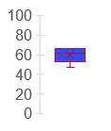
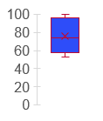
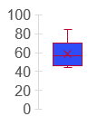
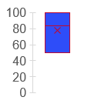
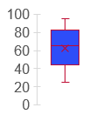
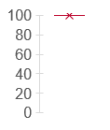
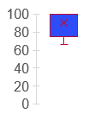
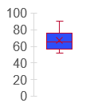
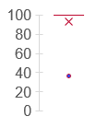
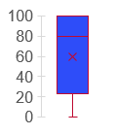
Country level scores for the 11 tHFA indicators
Supply Chain and Health Services Dashboard
High Quality Services
Integrated Supp. Supervision
Integrated HTM for ANC patients
System Readiness for CHWs
KPI Indicators
58
87
63
60
Facility Composite Score
CHW paid on time and in full
Community Led Monitoring
Availability of Guidelines
70
57
79
100
Non- KPI Indicators
Oxygen Therapy
Appropriate Testing
Staff Role Recruitment
High facility averages for guidelines, supportive supervision, availability of O2 and community led monitoring
Average means for xx, yy, zzz however these had a wide spread with highs of 90 an lows of 20 and below observed
97
85
70

Slide 15
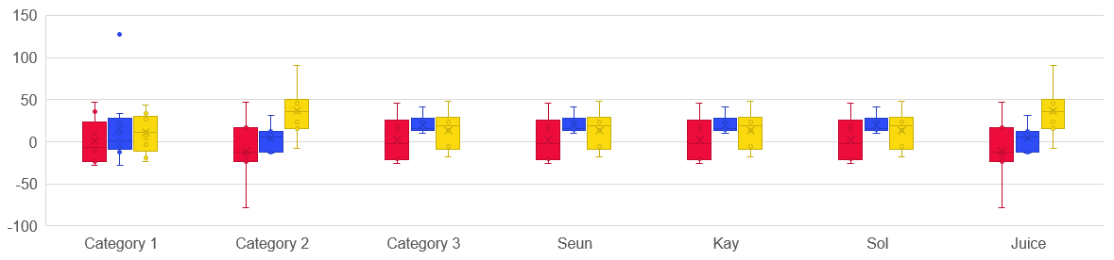
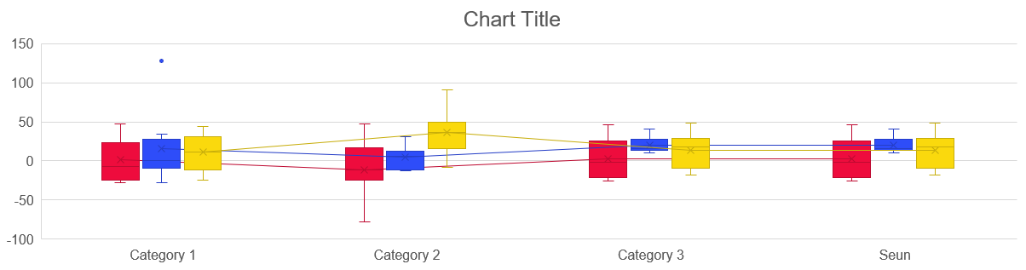
Distribution of all the things

Slide 16
KPI 1 : Provision of integrated, people-centered, high-quality services
Supply Chain and Health Services Dashboard
Country level indicator
11 tHFA Indicators
Primary health care
facilities
Secondary health care facilities
Tertiary health care
facilities
Add chart to show all indicator scores on this page
People-centeredness
Health worker competence

Slide 17
RSSH/PP HRH-7: Deep dive
Here we show the break down of the components feeding into the KPI and highlight the ones which are driving the numbers
Add any qualitative or country specific context or reasoning explaining the values for the components

Slide 18
So what is working well & what could improve – Conclusion
Works well
Areas of improvement
4-5 lines
Potential for improvement or areas where we see risks

Slide 19
What things could help with improving ? For open discussion
More like these might work rather than definitive statements

Slide 20
Thank you

Slide 21
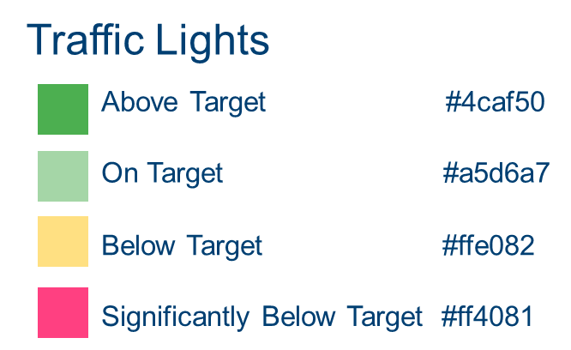
Performance thresholds and color codes
To use for KPI calculations
Performance thresholds
Color codes

Slide 22
Scope 1/3
What information/data are being collected in the questionnaire?
1. Facility Information​ | Facility location, type, level, services provided (HIV/AIDS, TB, Malaria, COVID-19).
2.1 Staff Impacted​ | Information related to staff availability and impacted by COVID-19​.
2.2 PPR-IPC​ | Information related to pandemic preparedness and response (PPR) including infection, prevention and control (IPC)​.
2.3 O2 Readiness​ | Information related to oxygen therapy readiness to provide services​.
2.4 Financing and Reporting​ | Information related to financing modalities and reporting status during COVID-19​.
2.5 Labs and Waste Management​ | Information related to waste collection and disposal management, and laboratory systems.​
2.6 COVID-19 Capacity​ | Information to assess the COVID-19 clinical pathway capacity of a health facility from testing to treatment​.
3. HIV, TB and Malaria Service Volume​ | Information from register records among services from 2019 to date.

Slide 23
Scope 2/3
4.1 Supply Chain HF OSA​​ | Data for the supply chain KPI “On-shelf Availability” for the selected tracer products belonging to the HIV, TB, malaria and COVID-19 product groups in scope for the Spot Checks at the health facility level. ​​
4.2 Supply Chain HF LMIS ​​ | Data on the quality of the data submitted to the country’s Logistics Management Information System (LMIS) for the HIV, TB, malaria and COVID-19 disease components at the health facility level. Three (3) key data quality elements are considered: data completeness, data accuracy and data timeliness. In addition, this section collects data on key challenges hindering the ability of health facilities to submit quality LMIS data to the central level. ​​
5.1 Supply Chain CMS OTIF​​ | Data for the supply chain KPI “On-Time-In Full” for the selected tracer products belonging to the HIV, TB, malaria and COVID-19 product groups in scope for the Spot Checks at the central storage facility (central level only). In addition, this section collects data on reasons impacting the central storage facility’s ability to deliver the right products in the right quantity and at the right time to the next supply chain level. ​​
5.2 Supply Chain CMS SATP​​ | Data for the supply chain KPI “Stocked According to Plan” for the selected tracer products belonging to the HIV, TB, malaria and COVID-19 product groups in scope for the Spot Checks at the central storage facility (central level only); data on the underlying reasons for stock imbalances (overstock, under stock, stock out situations). ​​

Slide 24
Scope 3/3
6. Supply Chain Central LMIS​​ | Data for the supply chain KPI “Facility Reporting to the LMIS” for the for the HIV, TB, malaria and COVID-19 disease components at the national level​​.
7. GSDP Questionnaire | Data for the Good Storage and Distribution Practice questionnaire. Five main sections of the questionnaire include: Preparatory information on prior audits; License and Registration; Quality Systems and Controls; Storage Capacity; Cold Chain Storage.

